Slide 2
Matthew 15:17-20 (NIV)
17 “Don’t you see that whatever enters the mouth goes into the stomach and then out of the body? 18 But the things that come out of a person’s mouth come from the heart, and these defile them. 19 For out of the heart come evil thoughts—murder, adultery, sexual immorality, theft, false testimony, slander. 20 These are what defile a person; but eating with unwashed hands does not defile them.”

Slide 3


Slide 4


Slide 5
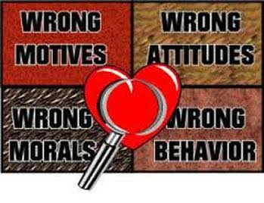
1. It CORRUPTS. (vv.1-6)
1 Then some Pharisees and teachers of the law came to Jesus from Jerusalem and asked, 2 “Why do your disciples break the tradition of the elders? They don’t wash their hands before they eat!”
3 Jesus replied, “And why do you break the command of God for the sake of your tradition? 4 For God said, ‘Honor your father and mother’[a] and ‘Anyone who curses their father or mother is to be put to death.’[b] 5 But you say that if anyone declares that what might have been used to help their father or mother is ‘devoted to God,’ 6 they are not to
‘honor their father or mother’ with it. Thus you nullify
the word of God for the sake of your tradition.

Slide 6

The Mishnah = an oral interpretation of the Law of God. This oral tradition was expanded to some 4,000 plus rules and regulations that covered every aspect of Jewish life. Included in this oral tradition were elaborate rules regarding external cleanliness, especially cleanliness related to hands.

Slide 7
Mark 7:9-13
9 And he continued, “You have a fine way of setting aside the commands of God in order to observe[c] your own traditions! 10 For Moses said, ‘Honor your father and mother,’[d] and, ‘Anyone who curses their father or mother is to be put to death.’[e] 11 But you say that if anyone declares that what might have been used to help their father or mother is Corban (that is, devoted to God)— 12 then you no longer let them do anything for their father or mother. 13 Thus you nullify the word of God by your tradition that you have handed down. And you do many things like that.”

Slide 8
2. It CONCEALS. (vv.7-14)
7 You hypocrites! Isaiah was right when he prophesied about you: 8 “‘These people honor me with their lips, but their hearts are far from me. 9 They worship me in vain; their teachings are merely human rules.’[c]” 10 Jesus called the crowd to him and said, “Listen and understand. 11 What goes into someone’s mouth does not defile them, but what comes out of their mouth, that is what defiles them.” 12 Then the disciples came to him and asked, “Do you know that the Pharisees were offended
when they heard this?” 13 He replied, “Every
plant that my heavenly Father has not planted
will be pulled up by the roots. 14 Leave them;
they are blind guides.[d] If the blind lead the
blind, both will fall into a pit.”

Slide 9
John 3:3
3 Jesus replied, “Very truly I tell you, no one can see the kingdom of God unless they are born again.”
John 14:6
6 Jesus answered, “I am the way and the truth and the life. No one comes to the Father except through me.

Slide 10
John 4:24
24 God is spirit, and his worshipers must worship in the Spirit and in truth.

Slide 11
Matthew 7:21-23
21 “Not everyone who says to me, ‘Lord, Lord,’ will enter the kingdom of heaven, but only the one who does the will of my Father who is in heaven. 22 Many will say to me on that day, ‘Lord, Lord, did we not prophesy in your name and in your name drive out demons and in your name perform many miracles?’ 23 Then I will tell them plainly, ‘I never knew you. Away from me, you evildoers!’

Slide 12
Jeremiah 17:9-10
9 The heart is deceitful above all things
and beyond cure.
Who can understand it?
10 “I the Lord search the heart
and examine the mind,
to reward each person according to their conduct,
according to what their deeds deserve.”

Slide 13

“Acknowledging spiritual condition and saying ‘Lord, You help me’ is so crucial.
Rev. Edmund Chan.

Slide 14
3. It CONFESSES. (vv.15-20)
15 Peter said, “Explain the parable to us.” 16 “Are you still so dull?” Jesus asked them. 17 “Don’t you see that whatever enters the mouth goes into the stomach and then out of the body? 18 But the things that come out of a person’s mouth come from the heart, and these defile them. 19 For out of the heart come evil thoughts—murder, adultery, sexual immorality, theft, false
testimony, slander. 20 These are what
defile a person; but eating with unwashed
hands does not defile them.”

Slide 15
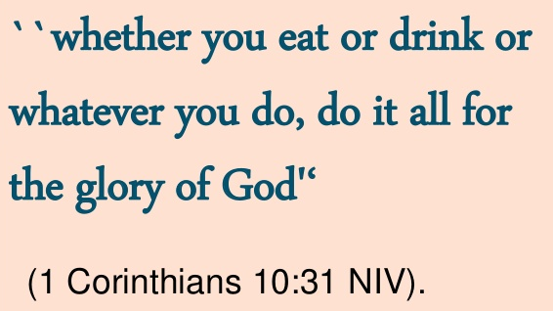

Slide 16


Slide 17
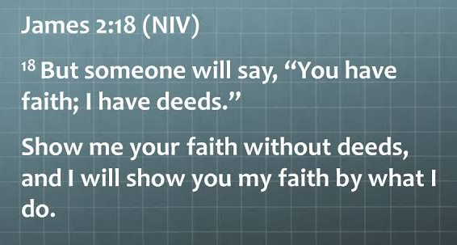

Slide 18


Slide 19
